Slide 1



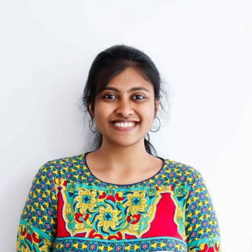

HARNESSING THE POTENTIAL OF A HEALTHY GUT MICROBIOME
Welcome to Your Community of Healing
This non-judgmental space is specially curated for Unison-Hexaware participants. Today we will learn about optimizing the diverse community of microorganisms in the gut to promote overall health and well-being.
We will try to be present in the session mentally and physically and learn about our mental health
Dikshaa Vikram
Clinical Nutritionist | Health Care Data Analytics Enthusiast
ManoShala Expert
You belong here!
MANOSHALA.COM

Slide 2

Identify a Healthy Plate
MANOSHALA.COM

Slide 3
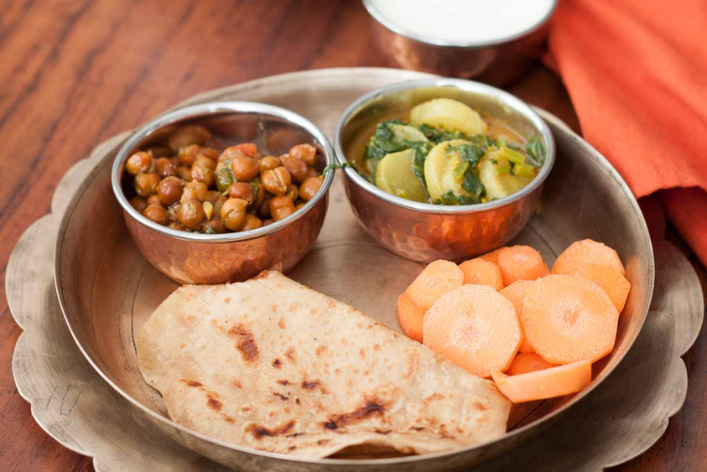
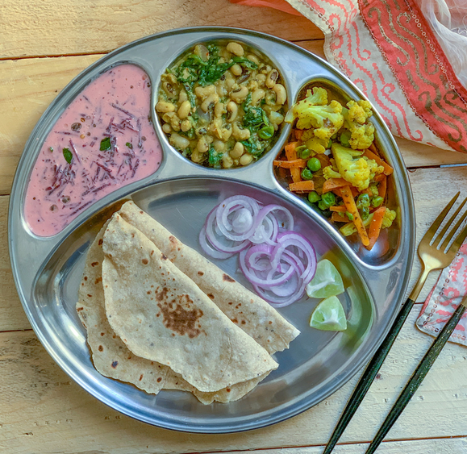
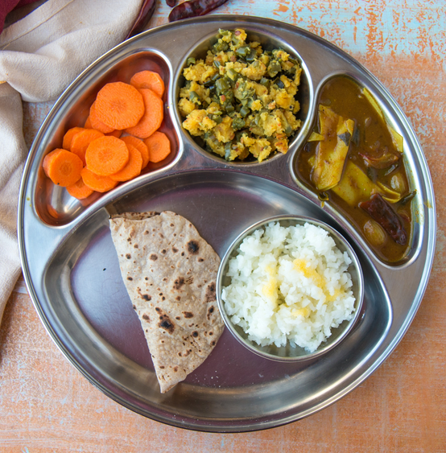
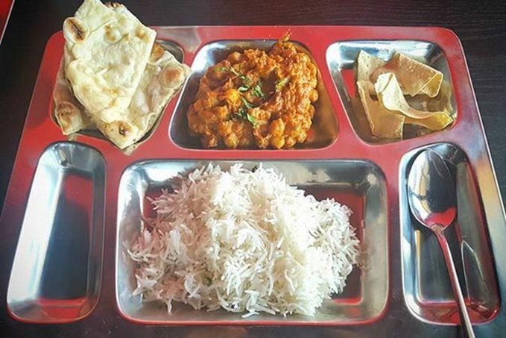
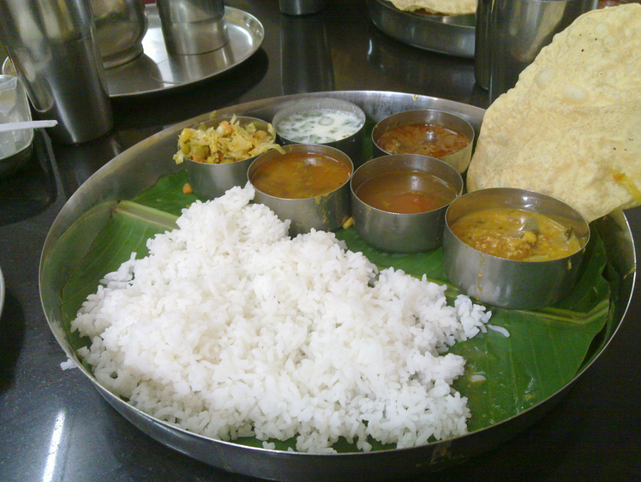
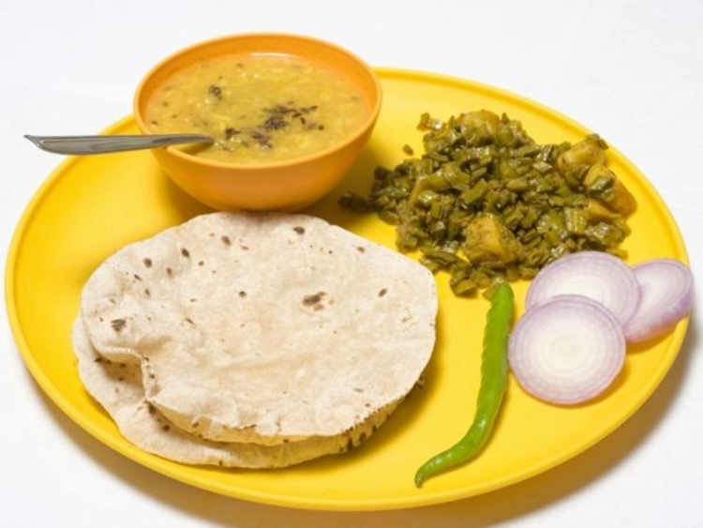
MANOSHALA.COM
MANOSHALA.COM
MANOSHALA.COM

Slide 4
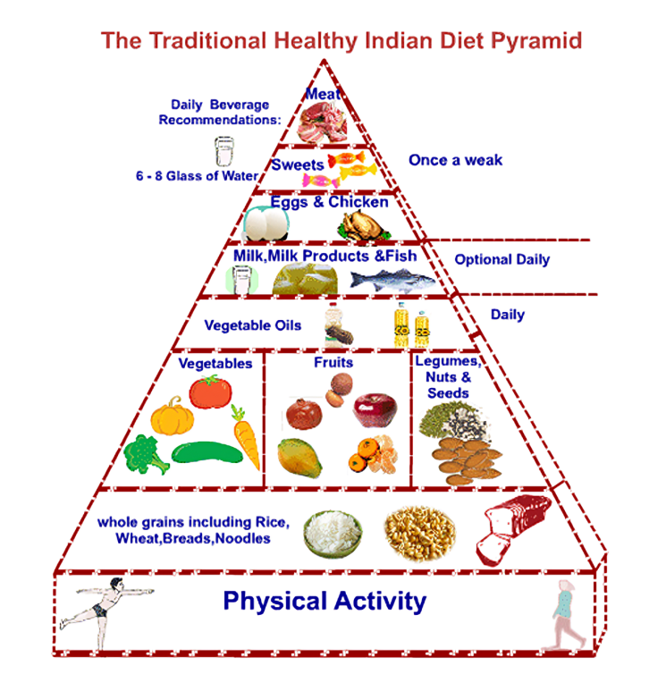

Healthy Plate Composition
Breakfast, lunch and dinner
MANOSHALA.COM

Slide 5
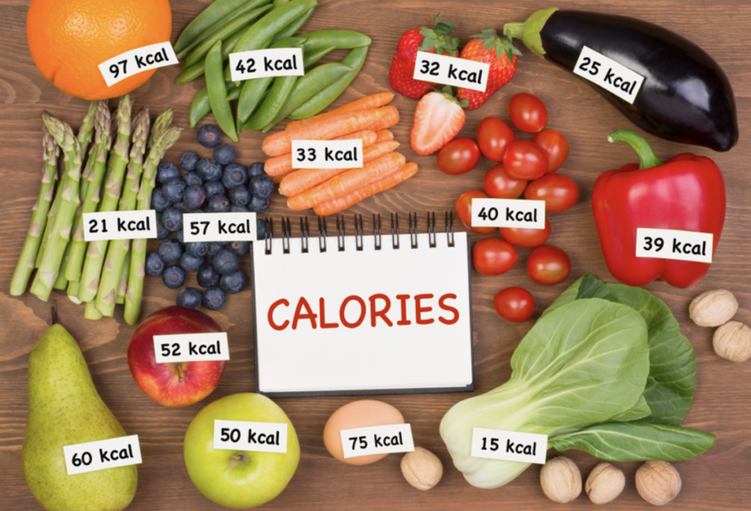
Checklist of Food
Vegetable - Any cut salad
Diary – Buttermilk/Curd/Milk
Or
Non veg – Egg/chicken/fish (bhurji/gravy/boiled form)
Or
Pulses – Moong/ Channa/Rajma/Cow pea/Soya bean/Meal maker (bhurji/gravy/boiled form salad)
Main Dish – Rice/chapati varieties
1 katori of vegetable salad + 1 katori of pulse + 1 or 1.5 katori of main dish +1 katori of curd/ 1 glass of milk or buttermilk
MANOSHALA.COM

Slide 6
Now Identify a Healthy Plate Again
MANOSHALA.COM

Slide 7

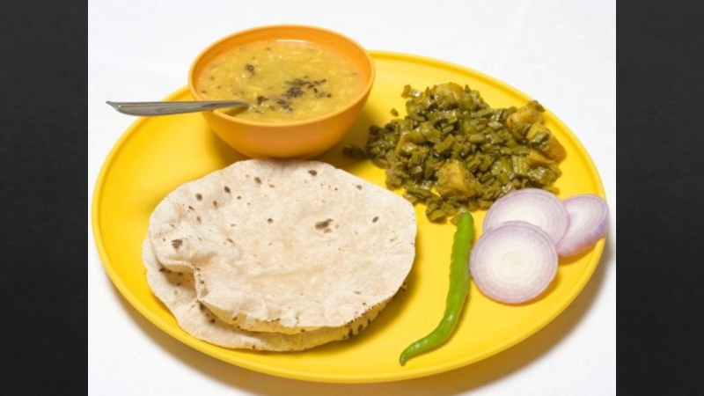
MANOSHALA.COM

Slide 8
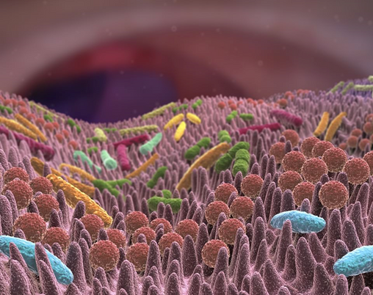
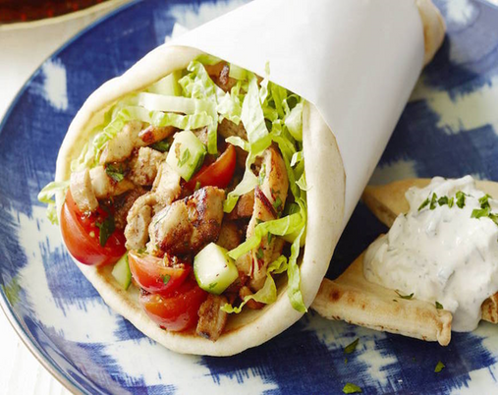
What is Gut?
"Gut" typically refers to the gastrointestinal (GI) tract or digestive system including organs such as the stomach, small intestine, and large intestine. It helps in food digestion and absorption, immune function and metabolism.
A long tube in the body through where food moves
Contains trillions of good bacteria and bad bacteria - Microbiome
Microbiome inside the gut is similar to the shawarma filling which as chicken/cabbage (good) and mayo (bad)
MANOSHALA.COM

Slide 9
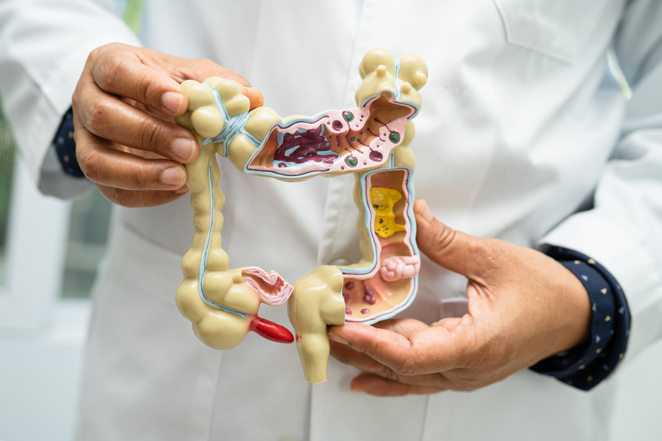
Importance of Gut Health
Breaks the food and helps to absorb nutrients for body’s functions
Immune system
Stress managment
Improved sleep quality
Digestion
MANOSHALA.COM

Slide 10


Assessing your Gut Health
Bloating
Frequent Fart
Burping
Constipation
Acidity
Quality of excreta
Burning in chest
MANOSHALA.COM

Slide 11


Signs of Unhealthy Gut
Increased Stress
Skin Issues
Fatigue
Nutritional deficiency
Autoimmune disease
Weight fluctuations
Sugar
cravings
MANOSHALA.COM

Slide 12

Factors Affecting Gut Health
MANOSHALA.COM

Slide 13

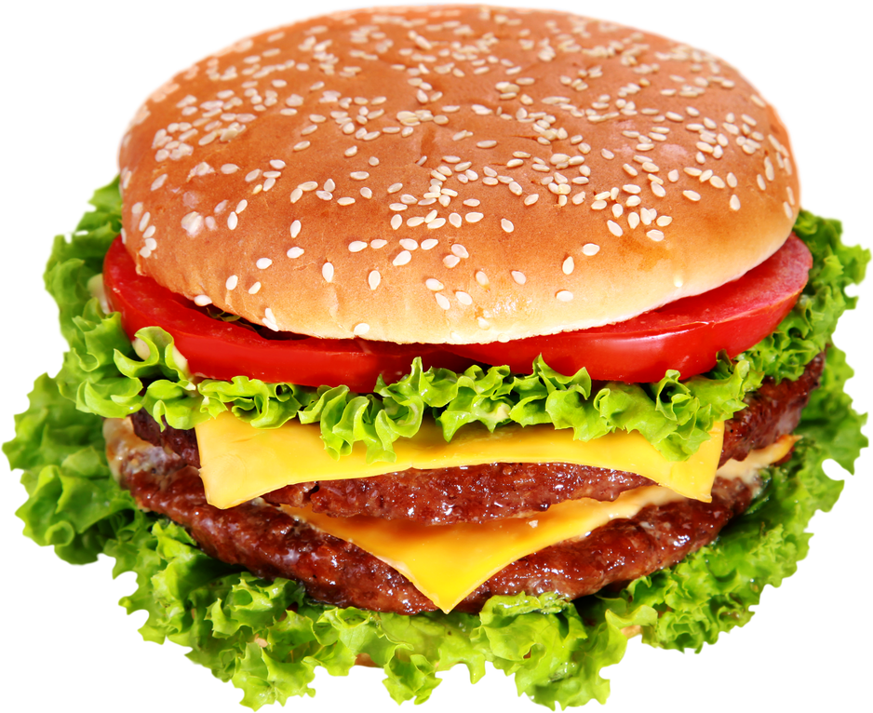




Factors Affecting Gut Health
Foods that we eat
Stress levels
Sleep
Physical activity
Genetics
MANOSHALA.COM

Slide 14
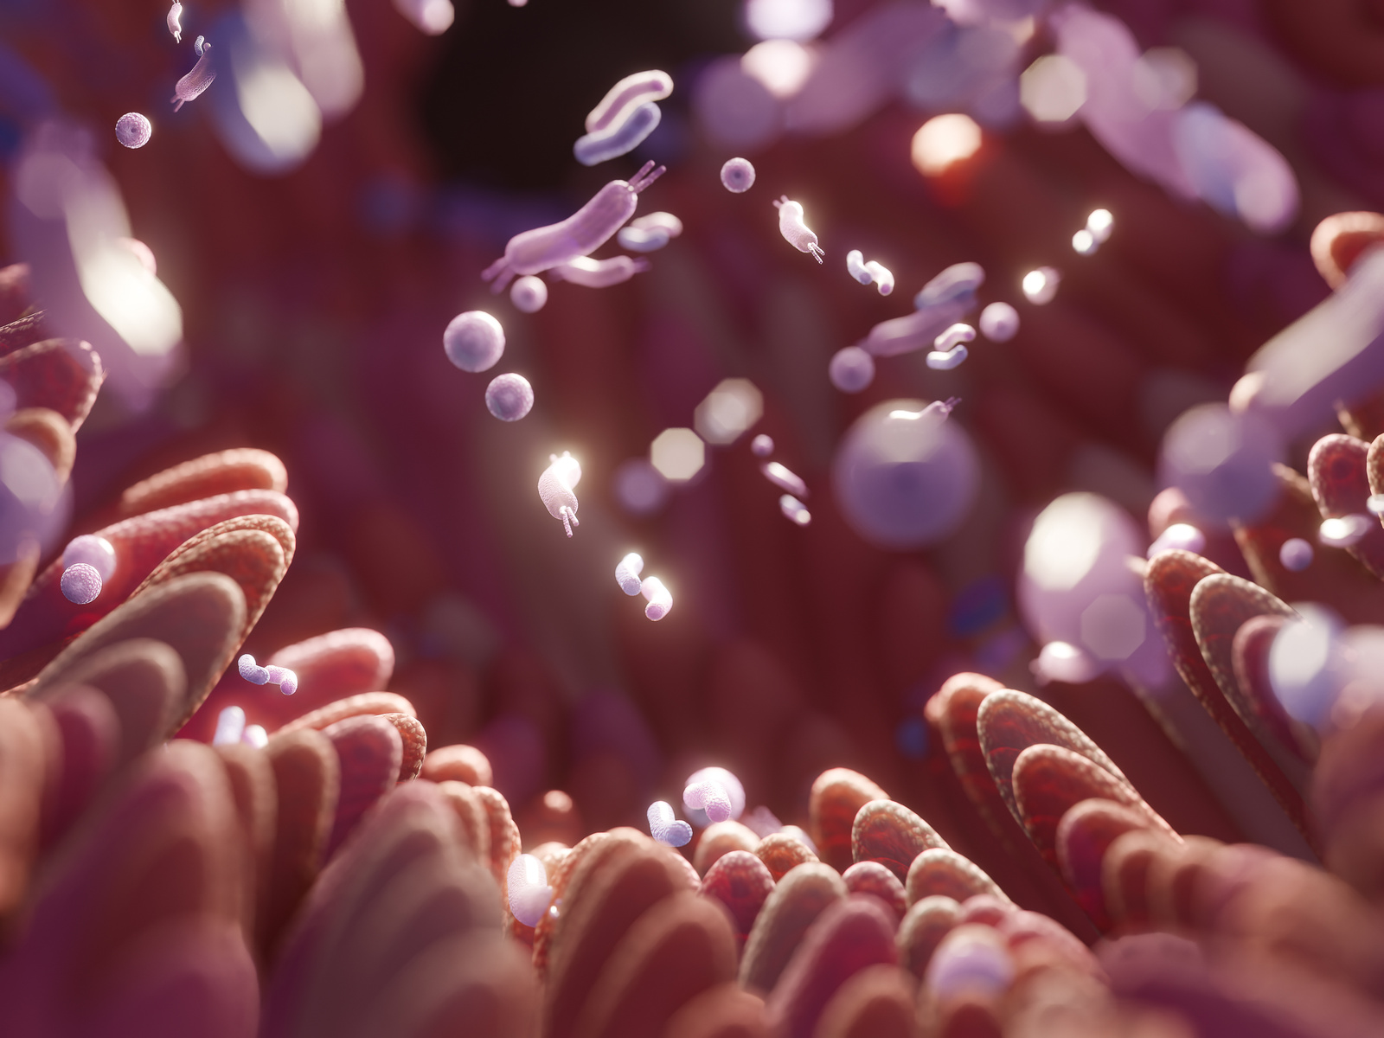

The Triad: Nutrition, Gut Health, and Stress
Nutrition and Gut
Food impacts the composition of our gut microbiota, the community of microorganisms living in our digestive tract.
A diet rich in fiber promotes a healthy gut microbiome essential for digestion.
A diet high in processed foods, sugars, and unhealthy fats can disrupt the balance of gut bacteria
MANOSHALA.COM

Slide 15
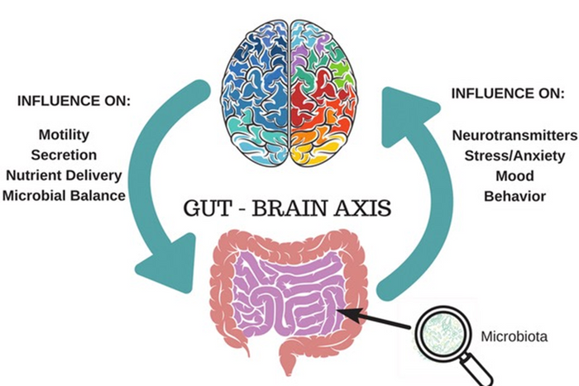
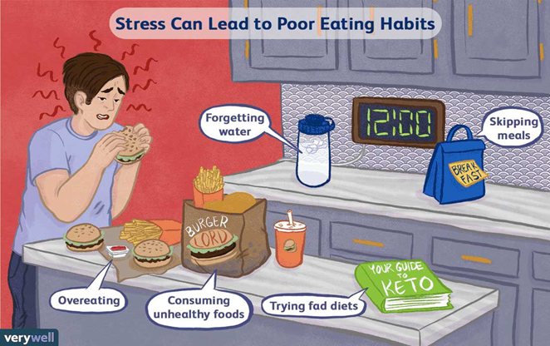
The Triad: Nutrition, Gut Health, and Stress
Gut Health and Stress:
The gut-brain axis is a bidirectional communication network mediated by the nervous, hormones, and immune systems.
Stress disrupts the balance of the gut microbiota and compromises gut barrier function, leading to increased intestinal permeability (leaky gut).
This triggers immune responses and inflammation, linked to various stress-related disorders, including anxiety, depression etc
MANOSHALA.COM

Slide 16
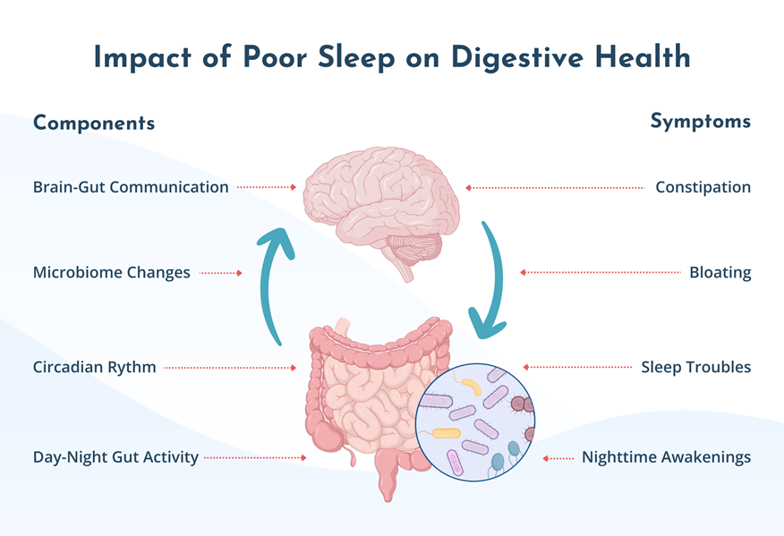
The Sleep: Hormonal Imbalances
MANOSHALA.COM

Slide 17
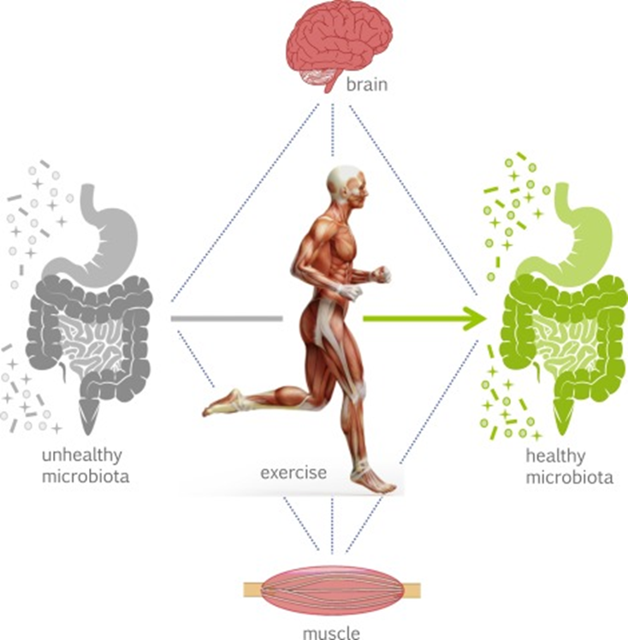
Physical Activity: Poor Gut Microbiome
MANOSHALA.COM

Slide 18
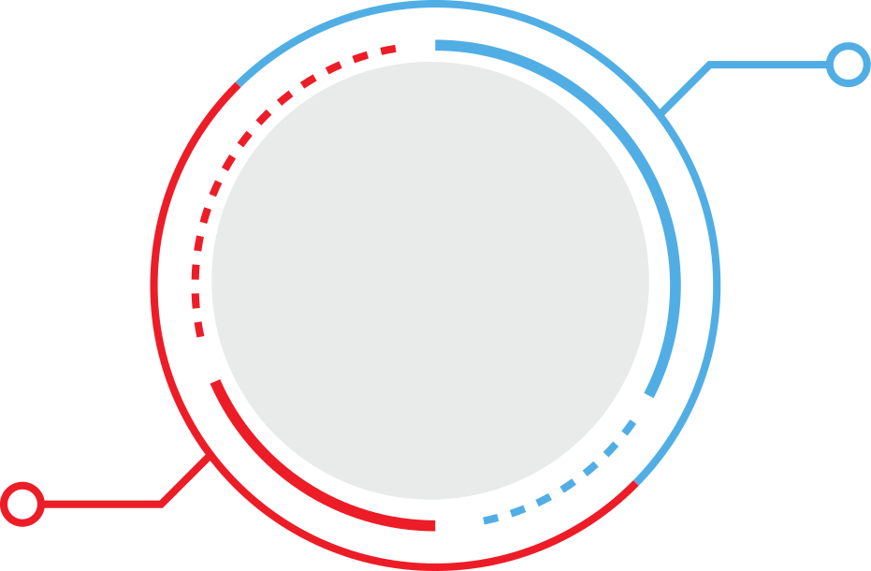
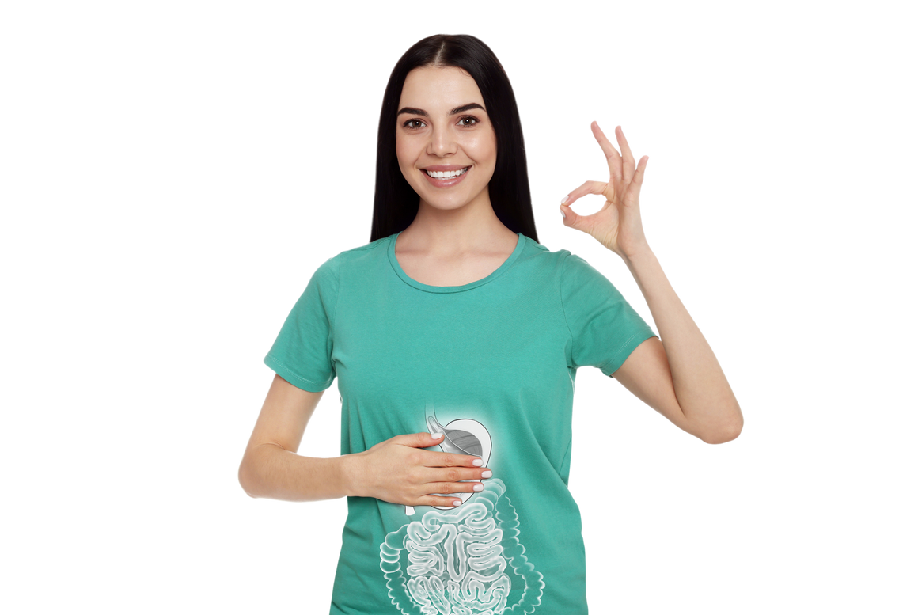
Lifestyle changes
Manage your Gut Health
Nutrition
MANOSHALA.COM

Slide 19

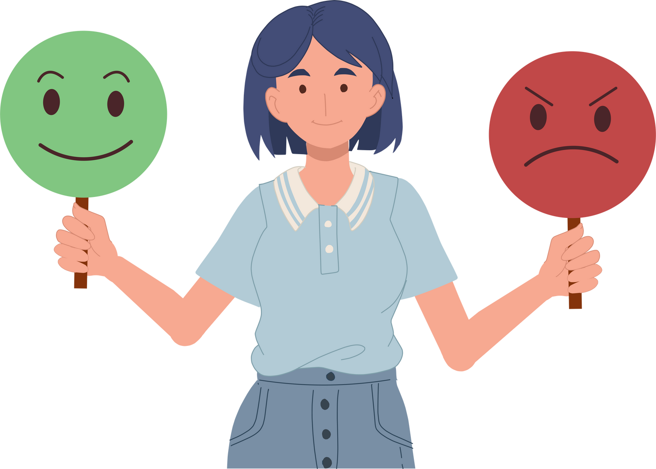
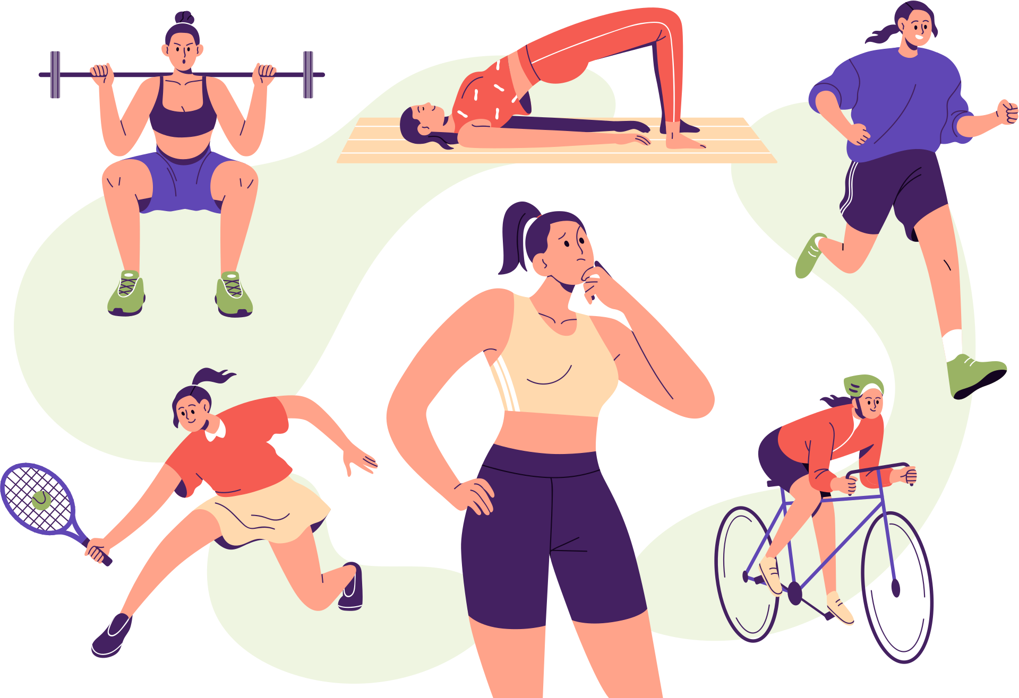

Lifestyle Habits
Mental
Emotional
Physical
Social
Practice mindfulness, stay away from screen 1 hour prior to bed
and set a bedtime sleep routine
Journal once a day and try therapy if its overwhelming for you
Keep small goals for the activity, stand up every 45 minutes, set 10,000 steps and wake up early
Speak to your friends, and family no matter how difficult you find it. Express gratitude toward them.
MANOSHALA.COM

Slide 20
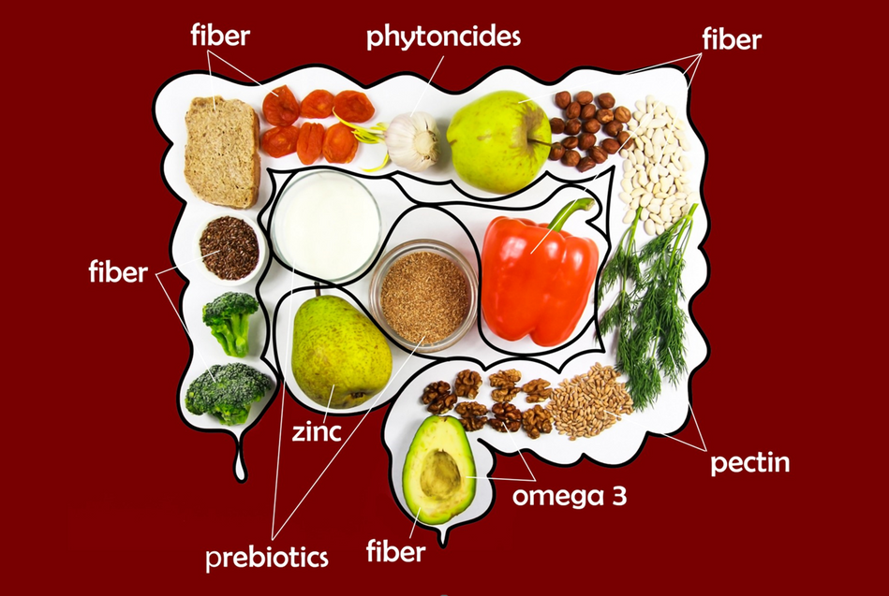

Nutrition Habits
Prebiotics
Probiotics
Prebiotics are indigestive fibers that feed good bacteria present in our body.
Probiotics are living micro organism that protect us from harmful bacteria.
Onions, Garlic, Bananas, Green leafy vegetables, Barley, Oats, Apples, Flax seeds etc
Yogurt, Curd, Buttermilk, Fermented Foods, Paneer etc
MANOSHALA.COM

Slide 21

Practical Changes to Try at Home
Healthy life ahead
MANOSHALA.COM

Slide 22
Simple formula to follow a balanced diet
Breakfast (Main dish + Protein + Diary)
Lunch (Rice/Roti + Protein + Vegetables + Diary)
Dinner (Main Dish + Protein + Diary + Vegetable salad)
Please note this is generic diet it will depend a lot on you personal body and genetics
MANOSHALA.COM

Slide 23
Balanced healthy eating combinations
Breakfast (Main dish + Protein + Diary)
Dosa (2) + Vegetable Sambar (1 cup) + Boiled egg/glass of milk
Idli (3) + Mint chutney (5 tbsp) + Boiled egg/glass of milk
Vegetable Upma (1 cup) + Curd (1 cup)
Vegetable poha (1 cup) + Curd (1 cup)
Pongal (1/2 cup) + Vegetable Sambar (1 cup) + Boiled egg/glass of milk
Please note this is generic diet it will depend a lot on you personal body and genetics
MANOSHALA.COM

Slide 24
Balanced healthy eating combinations
Lunch (Rice/Roti + Protein + Vegetables + Diary)
Rice (1 cup) + Vegetable sabji (1 cup) + Dhal (1 cup) + Buttermilk (1 glass) + Vegetable salad (1 cup)
Rice (1 cup) + Egg bhurji (1 cup) + Sambhar (1 cup) + Buttermilk (1 glass)+ Vegetable salad (1 cup)
Rice (1 cup) + Rasam (1 cup) + Boiled egg (1)+ Curd (1 cup)
Roti (1-2) + Dhal + Boiled Egg (1)+ Curd (1 cup)
Vegetable/Chicken Biriyani (1 cup) + Raita (1 cup)
Please note this is generic diet it will depend a lot on you personal body and genetics
MANOSHALA.COM

Slide 25
Balanced healthy eating combinations
Dinner (Main Dish + Protein + Diary + Vegetable salad)
Roti (1-2) + Panner Bhurji (1 cup) + Buttermilk (1 glass) + Vegetable salad (1 cup)
Roti (1-2) + Soya curry (1 cup) + Buttermilk (1 cup) + Vegetable salad (1 cup)
Idli (3) + Dhal (1 cup) + Curd (1 cup)
Dosa (2) + Rajma curry (1 cup) + Curd (1 cup)
Rice (1/2 cup) + Vegetable sambar (1 cup) + Curd (1 cup) + Vegetable salad
Please note this is generic diet it will depend a lot on you personal body and genetics
MANOSHALA.COM

Slide 26
List of Pre biotics and Pro biotics
Prebiotics
Probiotics
Garlic
Cabbage
Curd
Onions
Apples
Fermented batter
Banana
Watermelons
Kombucha
Green leafy Vegetables
Kidney beans
Dark chocolates
Mushrooms
Oats
Please note this is generic diet it will depend a lot on you personal body and genetics
MANOSHALA.COM

Slide 27
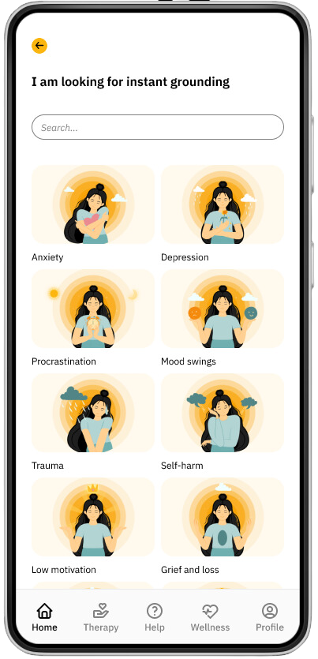
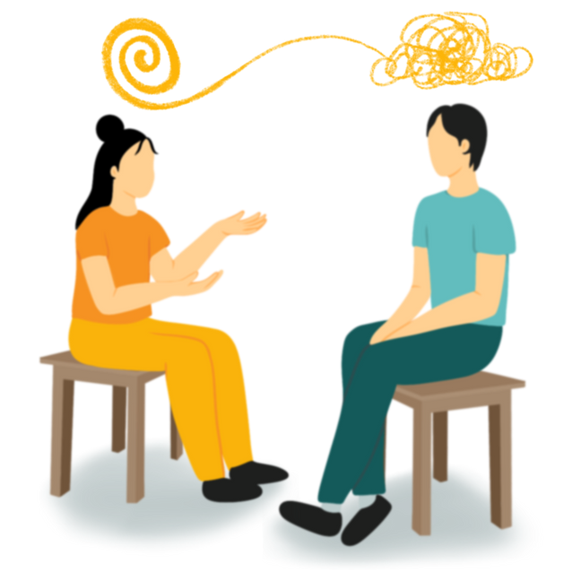
Thank You
20% OFF on Personal Counseling Therapy Sessions on App
MANOSHALA.COM

